Slide 1


OPEN
DATA
SCIENCE
CONFERENCE
@ODSC
Boston | May 2018
Ted Kwartler
Intro to Text Mining in R

Slide 2



Intro to Natural Language Processing
www.linkedin.com/in/edwardkwartler
@tkwartler

Slide 3

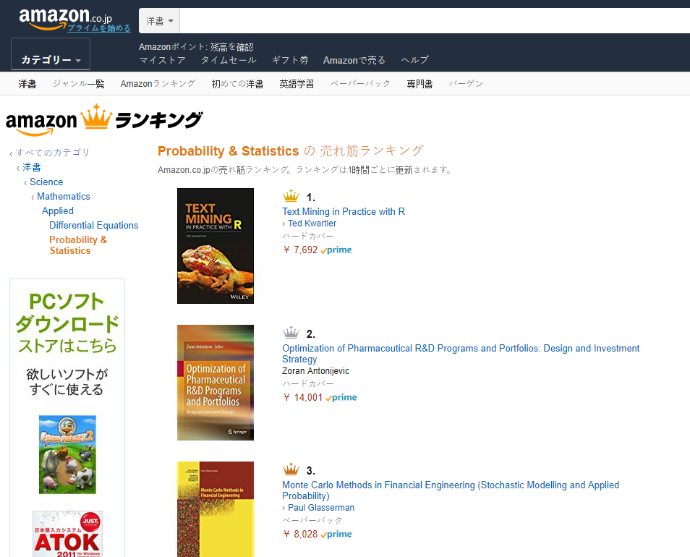
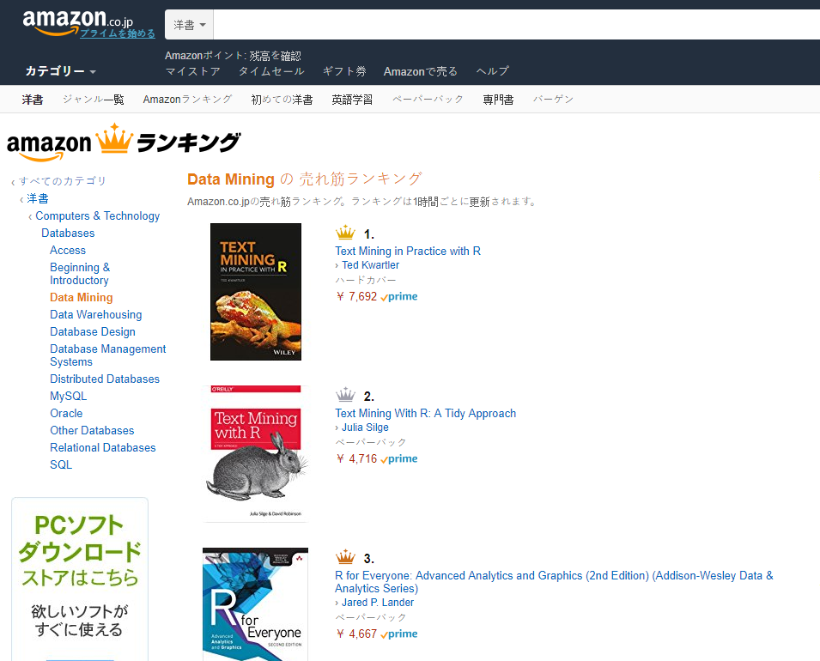
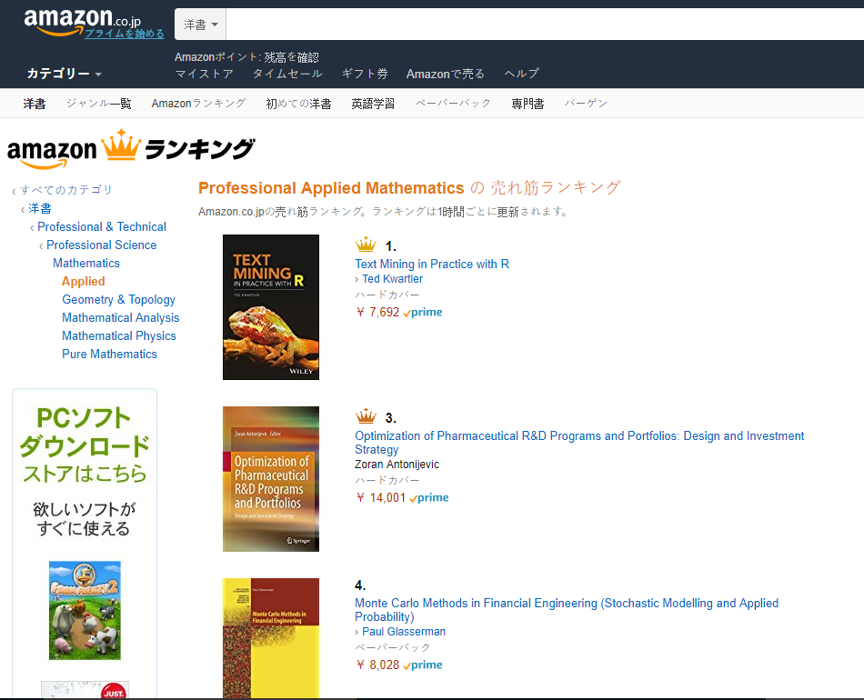
Shameless Plug #1
Shameless Plug #1
www.TedKwartler.com or
www.amazon.com or
www.wiley.com Discount Code: VBP65

Slide 4


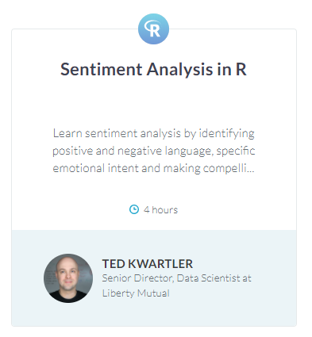
Shameless Plug #2
www.datacamp.com

Slide 5
Workshop Agenda
9-10:45
Intro to TM w/R
10:45-11
Break
11 – 11:45
Gather Text
11:45 – 12
Break
12-12:40
HTML Widgets
& Flexdashboard
12:40-12:50
Optional
Break
12:50-1
Scheduling
Goals:
Learn the basics of text mining
Apply methods to real data
Follow a business workflow for stakeholders needing text mining insights

Slide 6
Intro to TM w/R Deep Dive
9-10:45
Intro to TM w/R
10:45-11
Break
11 – 11:45
Gather Text
11:45 – 12
Break
12-12:40
HTML Widgets
& Flexdashboard
12:40-12:50
Optional
Break
12:50-1
Scheduling
What is Text Mining?
String Manipulation & Cleaning
Frequency Counts, Dendrograms & Wordclouds
Sentiment Analysis
Topic Modeling
OpenNLP/Named Entity Recognition
Goals:
Learn the basics of text mining
Apply methods to real data and uses
Follow a business workflow for stakeholders needing text mining insights

Slide 7
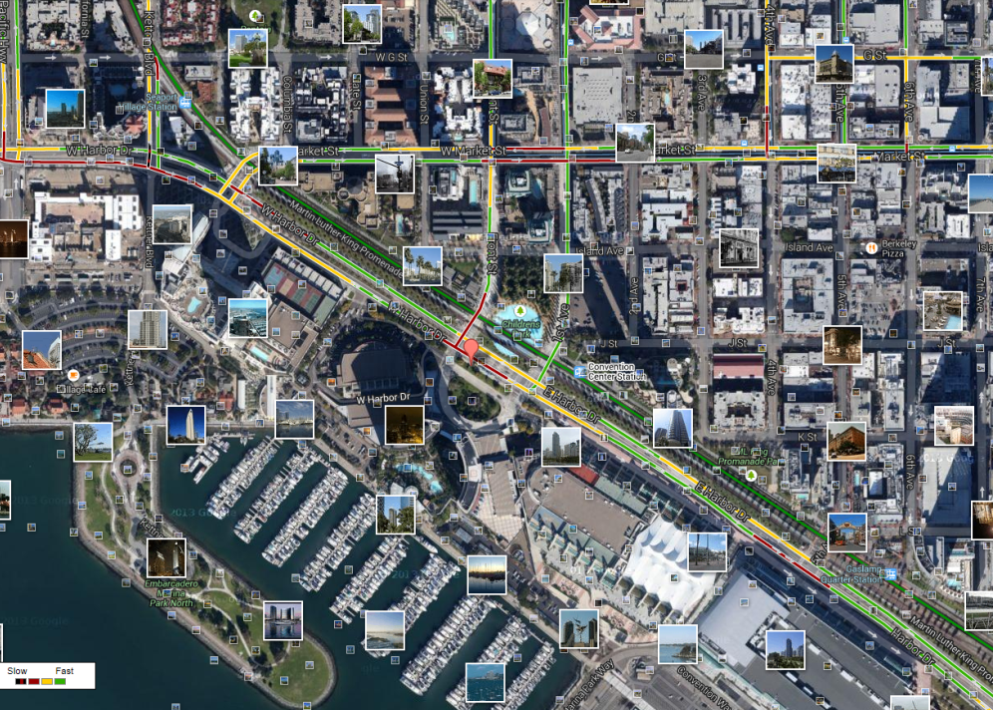
What is Text Mining?
Before Text Mining…
Extract new insights from text
Let’s you drink from a fire hose of information
Language is hard; many unsolved problems
Unstructured
Expression is individualistic
Multi-language/cultural implications

Slide 8
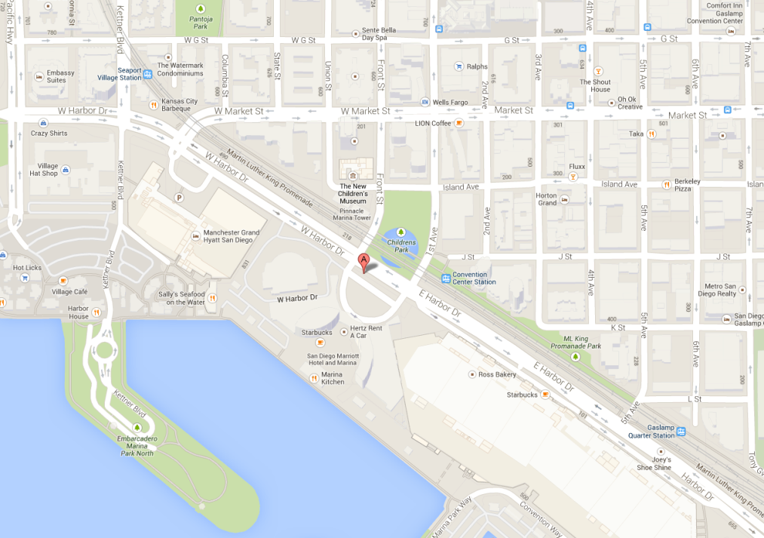
What is Text Mining?
After Text Mining…
Extract new insights from text
Let’s you drink from a fire hose of information
Language is hard; many unsolved problems
Unstructured
Expression is individualistic
Multi-language/cultural implications

Slide 9
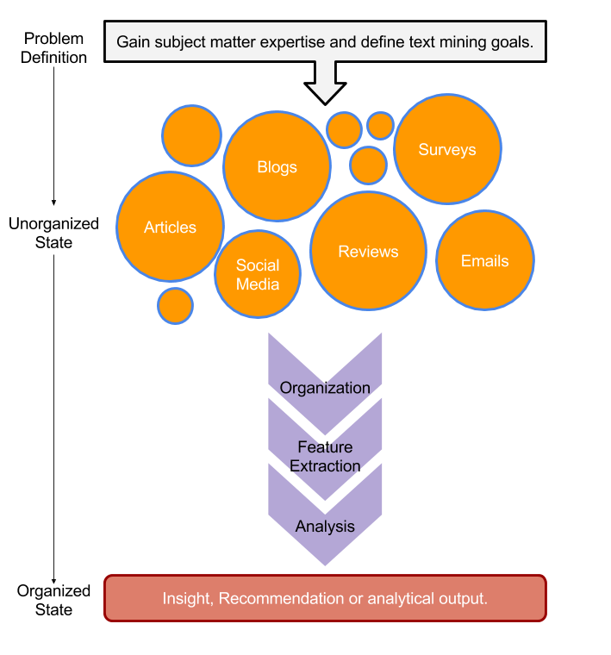
Text Mining Workflow
Problem Definition
Identify Text Sources
Text Organization
Feature Extraction
Analytics
Reach Insight or Recommendation

Slide 10
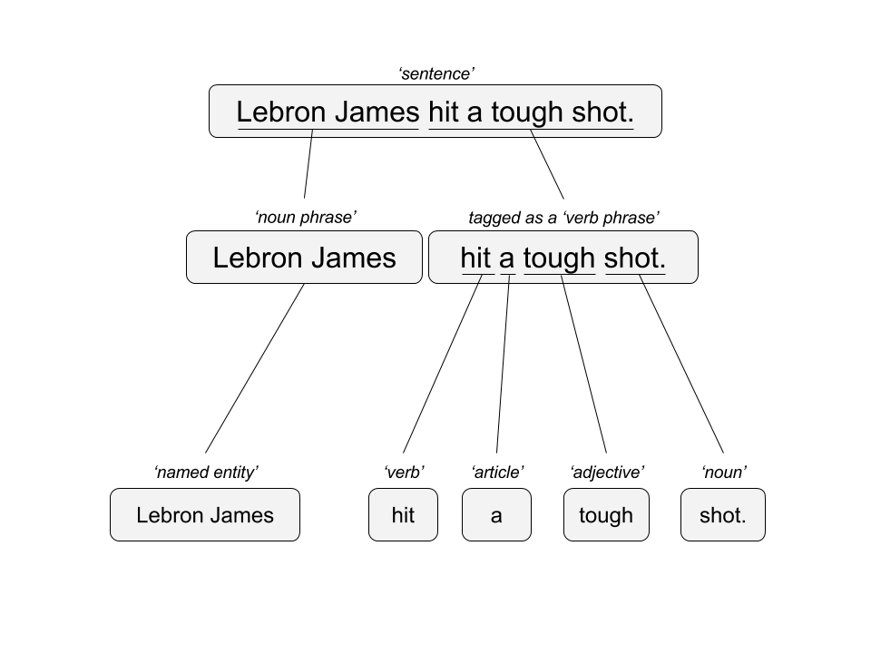

Two Popular Approaches*
“Lebron James hit a tough shot.”
Semantic Using Syntactic Parsing
Bag of Words
Lebron
a
James
hit
tough
shot
*There are other approaches usually based on DNN, that I refer to “abstractive”

Slide 11
Text Mining Approaches
Some Challenges in Text Mining
“I made her duck.”
Compound words (tokenization) changes meaning
“not bad” versus “bad”
Disambiguation
Sarcasm
“I like it…NOT!”
Cultural differences
“It’s wicked good” (in Boston)
I cooked waterfowl to eat.
I cooked waterfowl belonging to her.
I created the (clay?) duck and gave it to her.
Duck!!

Slide 12





Text Sources
Text can be captured within the enterprise and elsewhere
Books
Electronic Docs (PDFs)
Blogs
Websites
Social Media
Customer Records
Customer Service Notes
Notes
Emails
Legal Documents
…
The source and context of the medium is important. It will have a lot of impact on difficulty and data integrity.

Slide 13
Intro to TM w/R Deep Dive
What is Text Mining?
String Manipulation & Cleaning
Frequency Counts, Dendrograms & Wordclouds
Sentiment Analysis
Topic Modeling
OpenNLP/Named Entity Recognition
Goals:
Learn the basics of text mining
Apply methods to real data and uses
Follow a business workflow for stakeholders needing text mining insights

Slide 14
Enough of me talking…let’s do it for real!
Scripts in this workshop follow a simple workflow
Set the Working Directory
Load Libraries
Make Custom Functions & Specify Options
Read in Data & Pre-Process
Perform Analysis & Save

Slide 15
Enough of me talking…let’s do it for real!
Setup
# Get CRAN packages
libs<-c('stringi', 'tm', 'qdap', 'ggplot2',
'ggthemes', 'dendextend', 'wordcloud',
'RColorBrewer', 'tidytext', 'treemap',
'portfolio', 'GuardianR', 'lda', 'LDAvis',
'dplyr', 'servr', 'SnowballC', 'openNLP',
'jsonlite', 'pbapply', 'wordcloud2',
'rbokeh', 'radarchart', 'stringr',
'flexdashboard', 'rmarkdown', 'httr')
# Get most of the libs
install.packages(libs)

Slide 16
Enough of me talking…let’s do it for real!
Setup Continued
# WINDOWS Scheduler
install.packages('taskscheduleR')
# LINUX Scheduler
install.packages('cronR')
# Get a NLP Model for use w/openNLP
install.packages('openNLPmodels.en',
repos = "http://datacube.wu.ac.at/",
type = "source")

Slide 17
Warning: Twitter Profanity
Twitter demographics skew young and as a result have profanity that appear in the examples.
It’s the easiest place to get a lot of messy text fast, if it is offensive feel free to talk to me and I will work to get you other texts for use on your own. No offense is intended.
#%@*!!!

Slide 18
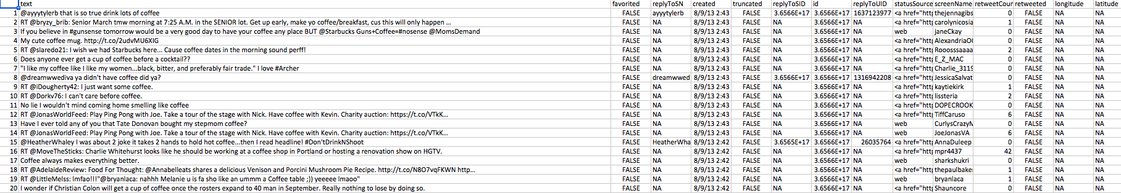
Open the “coffee.csv” to get familiar with the data structure
1000 tweets mentioning “coffee”
Setup
“text$text”
is the vector of tweets that we are interested in.
All other attributes are automatically returned from the twitter API

Slide 19
1_Keyword_Scanning.R
Basic R Unix Commands
Setup
grepl returns a vector of T/F if the pattern is present at least once
grepl(“pattern”, searchable object, ignore.case=TRUE)
grep returns the position of the pattern in the document
grep(“pattern”, searchable object, ignore.case=TRUE)
“library(stringi)” Functions
stri_count counts the number of patterns in a document
stri_count(searchable object, fixed=“pattern”)

Slide 20
1_Keyword_Scanning

Slide 21
Intro to TM w/R Deep Dive
What is Text Mining?
String Manipulation & Cleaning
Frequency Counts, Dendrograms & Wordclouds
Sentiment Analysis
Topic Modeling
OpenNLP/Named Entity Recognition
Goals:
Learn the basics of text mining
Apply methods to real data and uses
Follow a business workflow for stakeholders needing text mining insights

Slide 22
Remember This?
tweets
emails
surveys
blogs
reviews
articles

Slide 23
R for our Cleaning Steps
Setup
Tomorrow I’m going to have a nice glass of Chardonnay and wind down with a good book in the corner of the county :-)
tweets
emails
Remove Punctuation
Remove extra white space
Remove Numbers
Make Lower Case
Remove “stop” words
blogs
reviews
articles
tomorrow going nice glass chardonnay wind down good book corner county

Slide 24
2_Cleaning_and_Frequency_Count.R
“library(tm)” Functions
VCorpus creates a corpus held in memory.
Setup
VCorpus(source)
tm_map applies the transformations for the cleaning
tm_map(corpus, function)
getTransformations() will list all standard tm corpus transformations
We can apply standard R ones too. Sometimes it makes sense to perform all of these or a subset or even other transformations not listed like “stemming”
tm_map(corpus, removePunctuation) - removes the punctuation from the documents
tm_map(corpus, stripWhitespace) - extra spaces, tabs are removed
tm_map(corpus, removeNumbers) - removes numbers
tm_map(corpus, content_transformer(tolower)) – makes all case lower
tm_map(corpus, removeWords) - removes specific “stopwords”
New Text Mining Concepts
Corpus- A collection of documents that analysis will be based on.
Stopwords – are common words that provide very little insight, often articles like “a”, “the”. Customizing them is sometimes key in order to extract valuable insights.

Slide 25
2_Cleaning_and_Frequency_Count.R
“library(qdap)” Functions
Setup
Multiple Global Substitution
mgsub(“search pattern”, “replacement pattern”, text object)
Family of Replace Functions
replace_abbreviation()- Replace Abbreviations
replace_contraction()- Replace Contractions
replace_number()- Replace Numbers With Text Representation
replace_ordinal()- Replace Mixed Ordinal Numbers With Text Representation
replace_symbol()- Replace Symbols with Word Equivalents
To use on a corpus you need to apply content_transformer
tm_map(corpus, content_transformer(replace_abbreviation))
New Text Mining Concepts
Lemmatization in linguistics, is the process of grouping together the different inflected forms of a word so they can be analyzed as a single item.

Slide 26
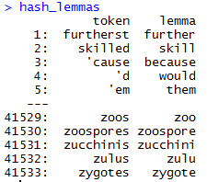
Poor Man’s lemmatization
library(lexicon)
Qdap’s mgsub() lets you easily aggregate words
#Poor Man's Lemmatization
data(hash_lemmas)
text$text <- mgsub(hash_lemmas$token,hash_lemmas$lemma,text$text)
Warning,: Not done in the workshop
because it takes a long time.

Slide 27
2_Cleaning_and_Frequency_Count.R
“tryTolower”is poached to account for errors when making lowercase.
tryTolower <- function(x){
# return NA when there is an error
y = NA
# tryCatch error
try_error = tryCatch(tolower(x), error = function(e) e)
# if not an error
if (!inherits(try_error, 'error'))
y = tolower(x)
return(y)
}
“clean.corpus” makes applying all transformations easier.
cleanCorpus<-function(corpus){
corpus <- tm_map(corpus, content_transformer(qdapRegex::rm_url))
corpus <- tm_map(corpus, removePunctuation)
corpus <- tm_map(corpus, stripWhitespace)
corpus <- tm_map(corpus, removeNumbers)
corpus <- tm_map(corpus, content_transformer(tryTolower))
corpus <- tm_map(corpus, removeWords, customStopwords)
return(corpus)
}
Base: tolower (basic)
Stringr: str_to_lower (wrapper)
Custom: tryTolower (handles errors)

Slide 28
2_Cleaning_and_Frequency_Count.R
“custom.stopwords” combines vectors of words to remove from the corpus
#Create custom stop words
custom.stopwords <- c(stopwords('english'), 'lol', 'smh')
Add channel specific stop words.
E.g. Twitter abbreviations
“custom.reader” keeps the meta data (tweet ID) with the original document
# Data
text<-read.csv('coffee.csv', header=TRUE)
# As of tm version 0.7-3 tabular was deprecated
names(text)[1]<-'doc_id' #first 2 columns must be 'doc_id' & 'text'
txtCorpus <- VCorpus(DataframeSource(text))
txtCorpus<-cleanCorpus(txtCorpus)

Slide 29
2_Cleaning_and_Frequency_Count.R
Bag of Words means creating a Term Document Matrix or Document Term Matrix*
Term Document Matrix
Setup
Document Term Matrix
 | Tweet1 | Tweet2 | Tweet3 | Tweet4 | … | Tweet_n
Term1 | 0 | 0 | 0 | 0 | 0 | 0
Term2 | 1 | 1 | 0 | 0 | 0 | 0
Term3 | 1 | 0 | 0 | 2 | 0 | 0
… | 0 | 0 | 3 | 0 | 1 | 1
Term_n | 0 | 0 | 0 | 1 | 1 | 0
 | Term1 | Term2 | Term3 | … | Term_n
Tweet1 | 0 | 1 | 1 | 0 | 0
Tweet2 | 0 | 1 | 0 | 0 | 0
Tweet3 | 0 | 0 | 0 | 3 | 0
… | 0 | 0 | 0 | 1 | 1
Tweet_n | 0 | 0 | 0 | 1 | 0
“as.matrix” makes the tm’s version of a matrix into a simpler version
txtDtm<-DocumentTermMatrix(txtCorpus)
txtTdm<-TermDocumentMatrix(txtCorpus)
txtDtmM<-as.matrix(txtDtm)
txtTdmM<-as.matrix(txtTdm)
These matrices are often very sparse and large therefore some special steps may be needed and will be covered in subsequent scripts.
*Depends on analysis, both are transpositions of the other

Slide 30
2_Cleaning_and_Frequency_Count.R

Slide 31
Intro to TM w/R Deep Dive
What is Text Mining?
String Manipulation & Cleaning
Frequency Counts, Dendrograms & Wordclouds
Sentiment Analysis
Topic Modeling
OpenNLP/Named Entity Recognition
Goals:
Learn the basics of text mining
Apply methods to real data and uses
Follow a business workflow for stakeholders needing text mining insights

Slide 32
3_Dendrogram.R
First let’s explore simple frequencies
Setup
beerFreq<-rowSums(beerTDMm)
beerFreq<-data.frame(word=names(beerFreq),frequency=beerFreq)
Term Document Matrix
 | Tweet1 | Tweet2 | Tweet3 | Tweet4 | … | Tweet_n
Term1 | 0 | 0 | 0 | 0 | 0 | 0
Term2 | 1 | 1 | 0 | 0 | 0 | 0
Term3 | 1 | 0 | 0 | 2 | 0 | 0
… | 0 | 0 | 3 | 0 | 1 | 1
Term_n | 0 | 0 | 0 | 1 | 1 | 0
word | freq
Term1 | 0
Term2 | 2
Term3 | 3
… | 5
Term_n | 2
Setup

Slide 33
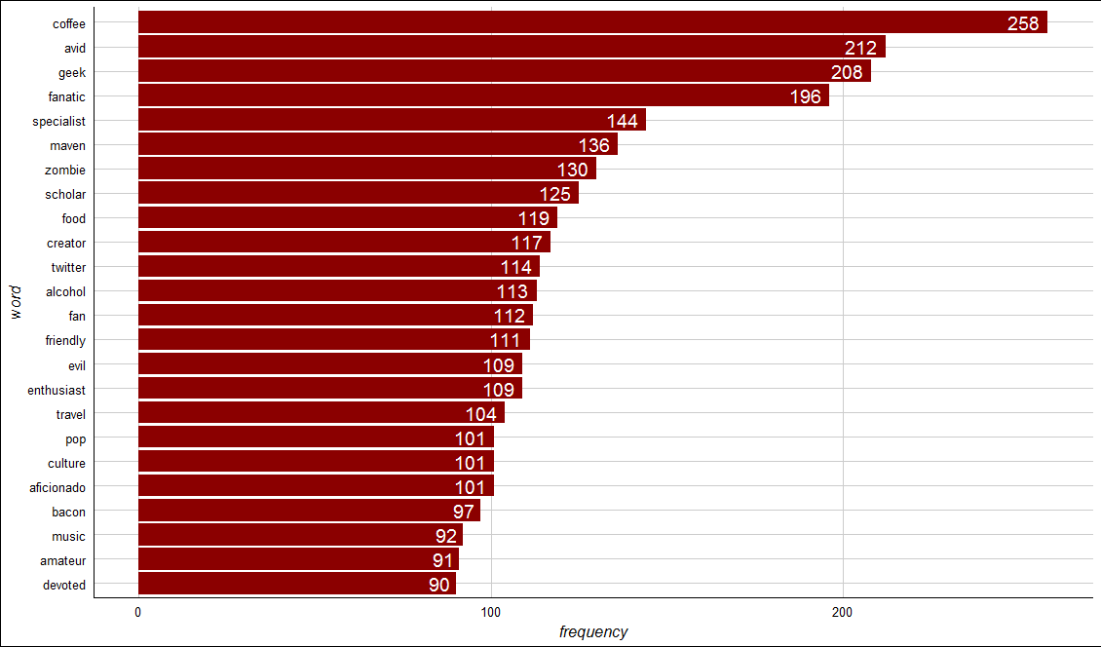
3_Dendrogram.R - ggplot
“zombie” is an unexpected, highly frequent term. Let’s explore it.

Slide 34
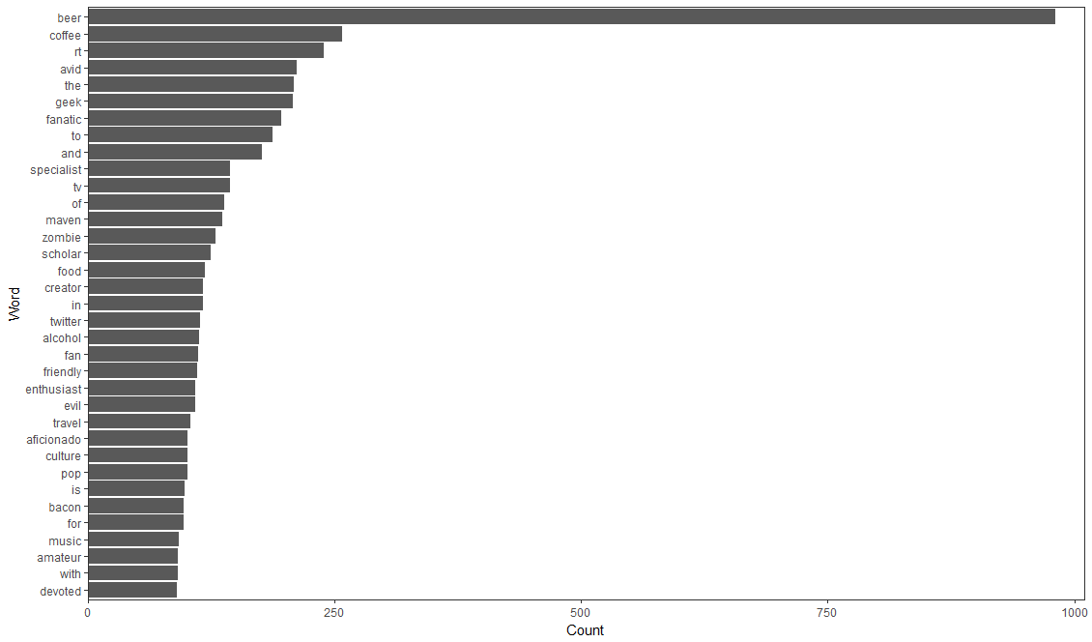
3_Dendrogram.R - qdap
Notice “beer” because not a stop word
Freq Counts, Dendrograms
Wordclouds

Slide 35
3_Dendrogram.R
Setup
Next let’s explore word associations, similar to correlation
# Inspect word associations
associations<-findAssocs(beerTDM, 'zombie', 0.30)
str(associations)
# Make a dot plot
zombieDF<-data.frame(terms=names(associations[[1]]),
value=unlist(associations))
zombieDF$terms<-factor(zombieDF$terms, levels=zombieDF$terms)
ggplot(zombieDF, aes(y=terms)) +
geom_point(aes(x=value), data=zombieDF, col='#c00c00') +
theme_gdocs() +
geom_text(aes(x=value,label=value), colour="red",hjust=-.25, size=3)
Adjust 0.30 to get the terms that are associated .30 or more with the ‘zombie’ term.
Treating the terms as factors lets ggplot2 sort them for a cleaner look.

Slide 36
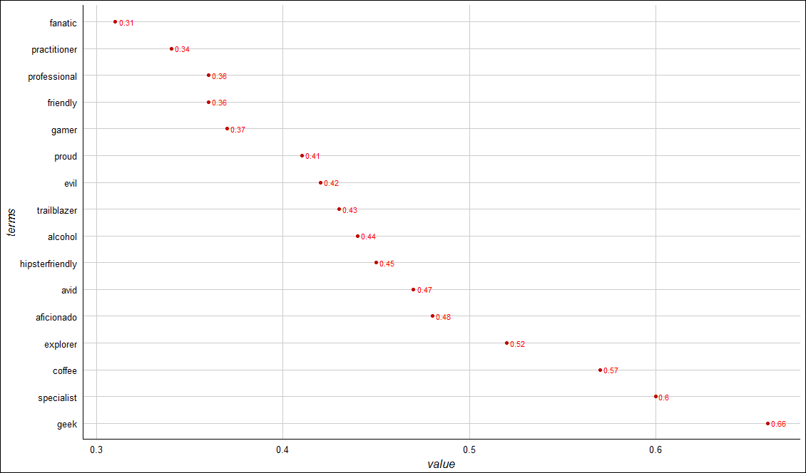
3_Dendrogram.R
“geek” has the highest word association with “zombie”.
Setup
Alcohol geek. Avid tv buff. Friendly beer aficionado. Coffee guru. Zombie junkie.

Slide 37
Extracting Meaning using dendrograms
Dendrograms visualize hierarchical clusters based on frequencies distances.
Reduces information much like average is a reduction of many observations’ values
Word clusters emerge often showing related terms
Term frequency is used to construct the word cluster. Put another way, term A and term B have similar frequencies in the matrix so they are considered a cluster.
Setup
63
City | Annual Rainfall
Portland | 43.5
Boston | 43.8
New Orleans | 62.7
44
New Orleans
Boston & Portland are a cluster at height 44. You lose some of the exact rainfall amount in order to cluster them.
Boston
Portland

Slide 38
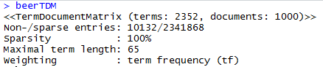
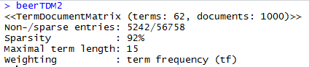
3_Dendrogram.R
Setup
Weird associations! Maybe a dendrogram will help us more
# Reduce TDM
beerTDM2 <- removeSparseTerms(beerTDM, sparse=0.97) #shoot for ~50 terms
beerTDM2<-as.data.frame(as.matrix(beerTDM2))
% of zeros allowed
e.g. higher means more words in TDM/DTM
New Text Mining Concept
Sparse- Term Document Matrices are often extremely sparse. This means that any document (column) has mostly zero’s. Reducing the dimensions of these matrices is possible by specifying a sparse cutoff parameter. Higher sparse parameter will bring in more terms.

Slide 39
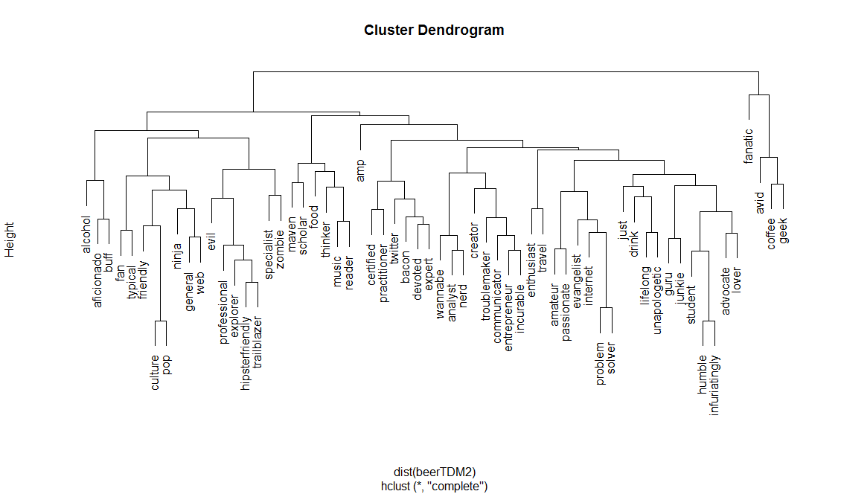
3_Dendrogram.R
Base Plot of a Dendrogram
Less visually appealing
Clusters can be hard to read given the different heights

Slide 40
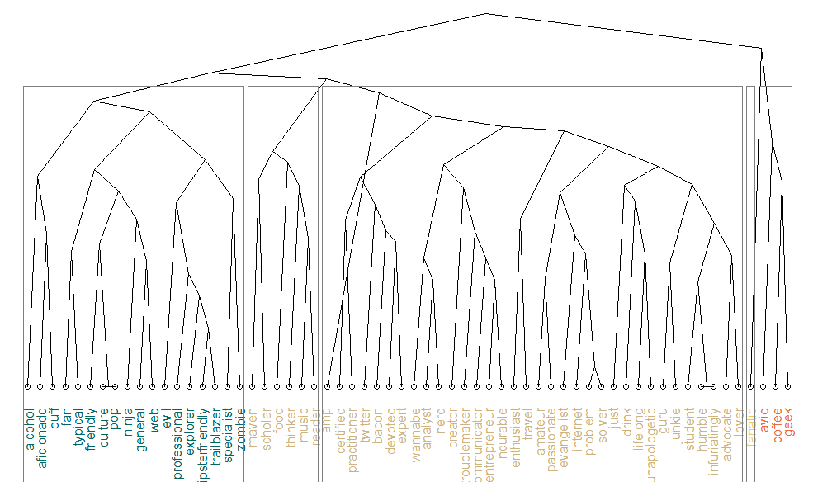
3_Dendrogram.R
Dendextend offers more flexibility

Slide 41
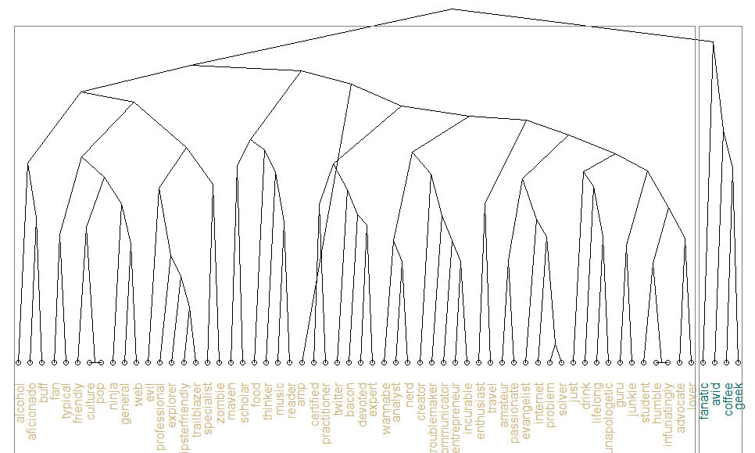
3_Dendrogram.R
Dendextend offers more flexibility

Slide 42
3_Dendrogram.R

Slide 43
Intro to TM w/R Deep Dive
What is Text Mining?
String Manipulation & Cleaning
Frequency Counts, Dendrograms & Wordclouds
Sentiment Analysis
Topic Modeling
OpenNLP/Named Entity Recognition
Goals:
Learn the basics of text mining
Apply methods to real data and uses
Follow a business workflow for stakeholders needing text mining insights

Slide 44
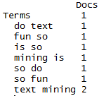
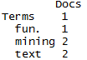
4_Simple_Wordcloud.R
#bigram token maker
bigramTokens <-function(x)
unlist(lapply(NLP::ngrams(words(x), 2), paste, collapse = " "), use.names = FALSE)
wineTDM<-TermDocumentMatrix(txtCorpus, control=list(tokenize=bigramTokens))
Text Mining is so fun. So do Text Mining!
Unigram
Bigram
*with common stopwords
New Text Mining Concept
Tokenization- So far we have created single word n-grams. We can create multi word “tokens” like bigrams, or trigrams with this line function. It is applied when making the term document matrix.

Slide 45
4_Simple_Wordcloud.R
To make a wordcloud we follow the previous steps and create a data frame with the word and the frequency.
# Get Row Sums
wineTDMv <- sort(rowSums(wineTDMm),decreasing=TRUE)
wineDF <- data.frame(word = names(wineTDMv),freq=wineTDMv)
Term Document Matrix
 | Tweet1 | Tweet2 | Tweet3 | Tweet4 | … | Tweet_n
Term1 | 0 | 0 | 0 | 0 | 0 | 0
Term2 | 1 | 1 | 0 | 0 | 0 | 0
Term3 | 1 | 0 | 0 | 2 | 0 | 0
… | 0 | 0 | 3 | 0 | 1 | 1
Term_n | 0 | 0 | 0 | 1 | 1 | 0
word | freq
Term1 | 0
Term2 | 2
Term3 | 3
… | 5
Term_n | 2
Setup

Slide 46
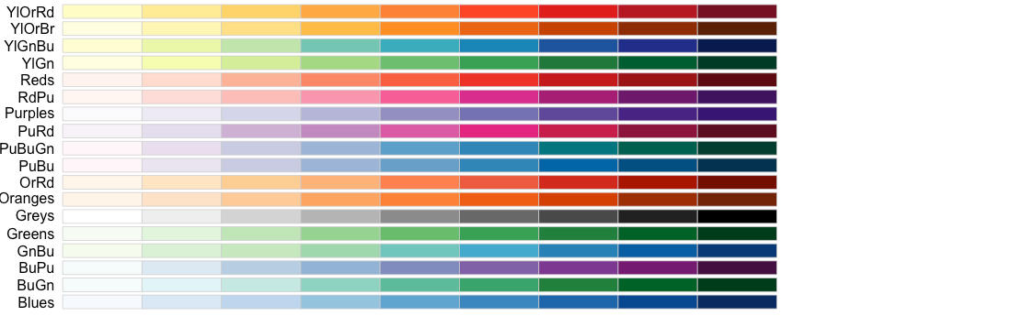
4_Simple_Wordcloud.R
Next we need to select the colors for the wordcloud.
# Review all Pallettes
display.brewer.all()
# Choose a color & drop light ones
pal <- brewer.pal(8, "Blues")
pal <- pal[-(1:2)]

Slide 47
4_Simple_Wordcloud.R

Slide 48
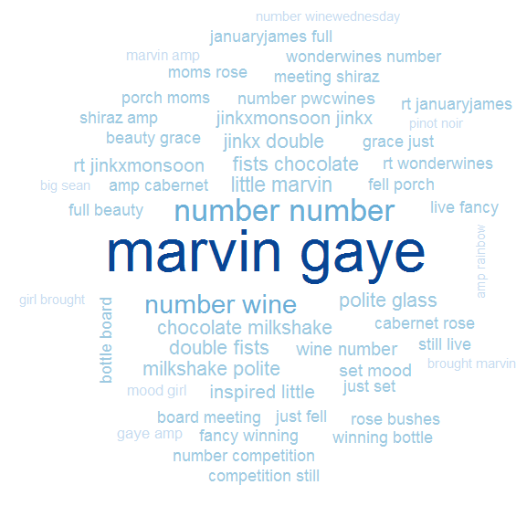
4_Simple_Wordcloud.R
set.seed(1234)
wordcloud(wineDF$word,wineDF$freq,max.words=50, random.order=FALSE, colors=pal)
Bigram Tokenization has captured “marvin gaye”
A word cloud is a frequency visualization. The larger the term (or bigram here) the more frequent the term.
You may get warnings if certain tokens are to large to be plotted in the graphics device.
In cleanCopurs() the function … changes numeric with the generic string “number” so be careful with your preprocessing steps!

Slide 49
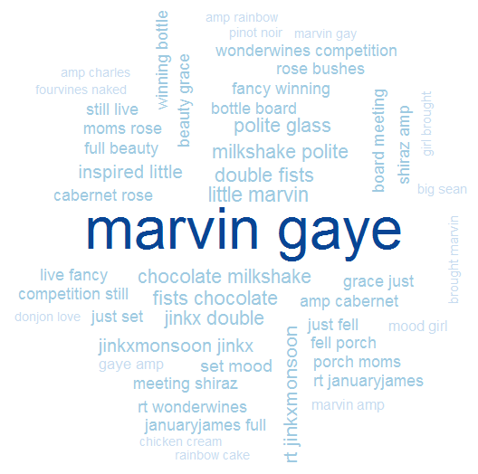
4_Simple_Wordcloud.R
In cleanCopurs() the function replace_symbol() changes numeric with the generic string “number” so be careful with your preprocessing steps!

Slide 50
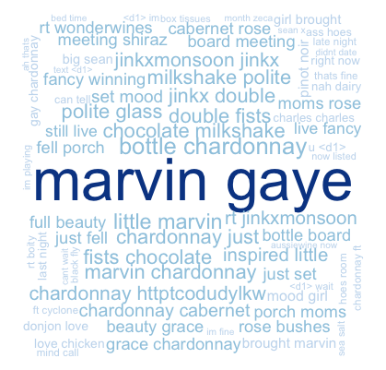
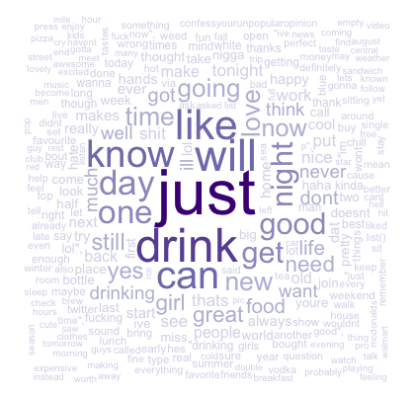
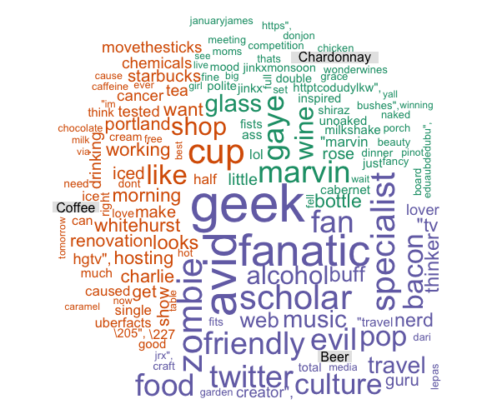
Types of Wordclouds
Multiple Corpora
Single Corpus
wordcloud( )
comparison.cloud( )
commonality.cloud( )
comparison.cloud( )
comparison.cloud( )

Slide 51
5_Other_Wordclouds.R
The challenge is working with multiple corpora efficiently. Many ways to do it…
# Read in multiple files as individuals
txtFiles<-c('chardonnay.csv','coffee.csv','beer.csv') #use list.files() for a lot
for (i in 1:length(txtFiles)){
assign(txtFiles[i], read.csv(txtFiles[i]))
cat(paste('read completed:',txtFiles[i],'\n'))
}
# Read them into a single list with individual elements
all<-pblapply(txtFiles,read.csv)
Two ways to import csv files:
Each file is read in and an object created for each.
A list called “all” is created. Each list element represents a single document. Using data.table::rbindlist() one can create a single document from all files in the folder.

Slide 52
5_Other_Wordclouds.R

Slide 53
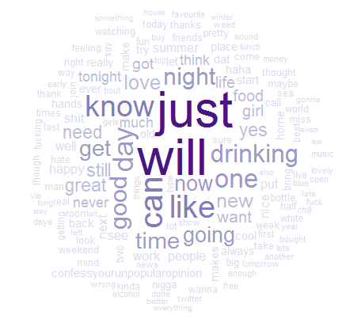
Commonality Cloud
The tweets mentioning “chardonnay” “beer”, and “coffee” have these words in common.
Again size is related to frequency.
Not helpful in this but in diverse corpora it may be more helpful e.g. political speeches.
# Make commonality cloud
commonality.cloud(drinkTDMm, max.words=150, random.order=FALSE,colors=pal)

Slide 54
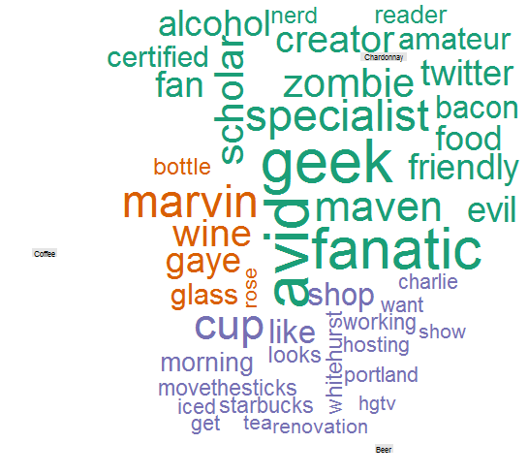
Comparison Cloud
The tweets mentioning “chardonnay” “beer”, and “coffee” have these dissimilar words.
Again size is related to frequency.
Beer drinkers in this snapshot are passionate (fanatics, geeks, specialists) on various subjects while Chardonnay drinkers mention Marvin Gaye. Coffee mentions up & working.
# Make comparison cloud
comparison.cloud(drinkTDMm, max.words=75, random.order=FALSE, title.size=0.5,colors=brewer.pal(ncol(drinkTDMm),"Dark2"))

Slide 55
Intro to TM w/R Deep Dive
What is Text Mining?
String Manipulation & Cleaning
Frequency Counts, Dendrograms & Wordclouds
Sentiment Analysis
Topic Modeling
OpenNLP/Named Entity Recognition
Goals:
Learn the basics of text mining
Apply methods to real data and uses
Follow a business workflow for stakeholders needing text mining insights

Slide 56
Simple Sentiment Polarity
Scoring
Zipf’s Law
Surprise is a sentiment.
Hit by a bus! – Negative Polarity
Won the lottery!- Positive Polarity
Many words in natural language but there is steep decline in everyday usage. Follows a predictable pattern.
I loathe BestBuy Service -1
I love BestBuy Service. They are the best. +2
I like shopping at BestBuy but hate traffic. 0
R’s QDAP polarity function scans for positive words, and negative words as defined by MQPA Academic Lexicon research. It adds positive words and subtracts negative ones along with valence shifters. The final score represents the polarity of the social interaction.

Slide 57
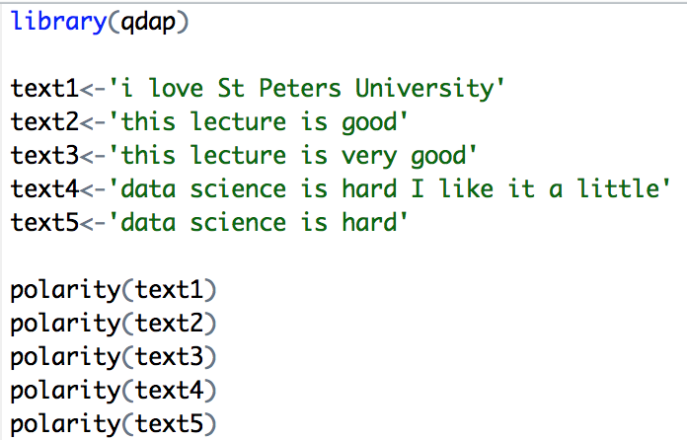
Simple Sentiment Polarity
Scoring
Text 1: “love” was identified as positive. The text has 5 words and so 1/sqrt(5) = .447
Text 2: “good” was identified positively. So 1/sqrt(4)=.5
Text 3: “good” was found along with the amplifier “very”. So (.8+1)/sqrt(5)=.805
Text 4: hard and like cancel each other out so the polarity is zero. 1-1/sqrt(9)=0
Text 5: “hard” is -1/sqrt(4)=-.50
First it looks for the polarized word. Then identifies valence shifters (default 4 words before and two words after) Amplifiers are assigned +.8 and de-amplifiers weight is constrained to -1. Lastly the sum is divided by the square root of the total number of words in the passage.

Slide 58
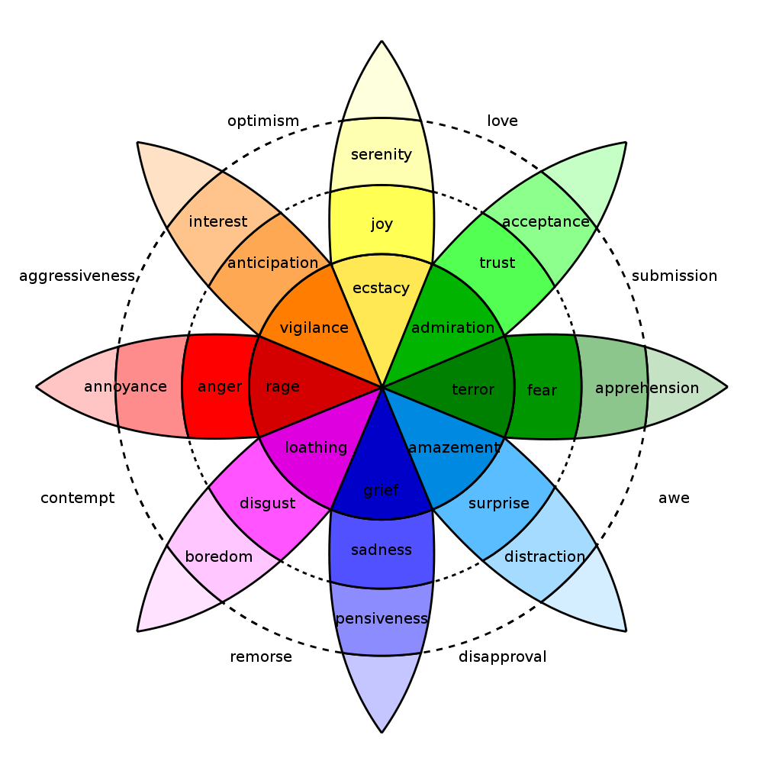
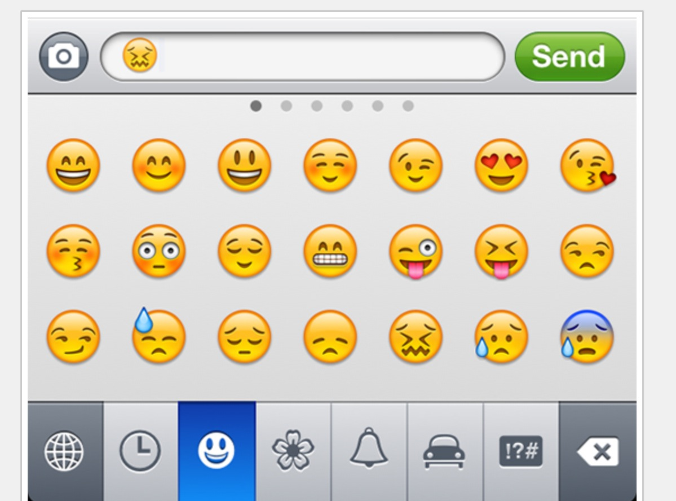
In reality sentiment is more complex.
Many Many Emoji
Plutchik’s Wheel

Slide 59
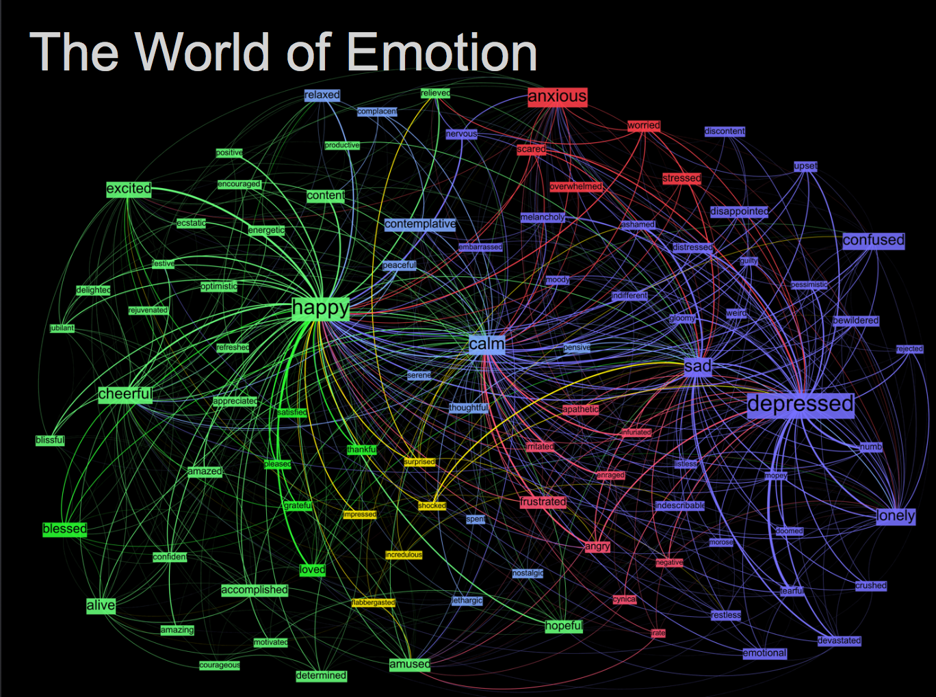
Kanjoya’s Experience Corpus

Slide 60
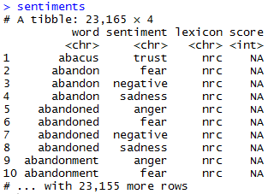
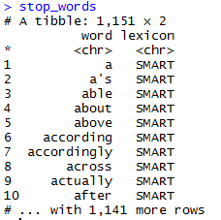
Sentiment the Tidy Way!
##Tidy Sentiment Analysis
data(sentiments)
sentiments
#Stopwords
data(stop_words)
stop_words
#Add stopwords
custom.stopwords<-data.frame(word=c('amp','beer'),
lexicon='custom')
stop_words<-rbind(stop_words,custom.stopwords)

Slide 61
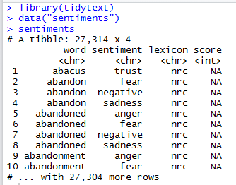
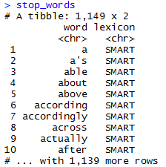
6_TidyText_Sentiment.R
Tidytext is part of the tidy universe including ggplot and dplyr. Code is structured so it is more easily read using the %>%. The data format is a tibble and is in “tidy” format (long form).
mtcars %>% group_by(cyl) %>% mutate(rank = min_rank(desc(mpg)))
This reads as “Using the mtcars object then group by the cyl vector then mutate a new variable called rank.

Slide 62


Slide 63
6_TidyText_Sentiment.R
The pipe operator
%>%
Forwards an object so the code is easy to understand & concise.
Tweet words
Stop words
all.tidy <- all.tidy %>%
anti_join(stop_words)
anti_join()
text
Sentiment words
all.sentiment <- all.tidy %>%
inner_join(nrc.lexicon) %>%
count(tweet,sentiment) %>%
spread(tweet, n, fill = 0)
inner_join()

Slide 64
6_TidyText_Sentiment.R
# DTM
txtDTM<-DocumentTermMatrix(txtCorpus)
txtDTM
dim(txtDTM)
# Tidy
tidyCorp<-tidy(txtDTM)
tidyCorp
dim(tidyCorp)
# Get bing lexicon
# "afinn", "bing", "nrc", "loughran"
bing<-get_sentiments(lexicon = c("bing"))
head(bing)
# Perform Inner Join
bingSent<-inner_join(tidyCorp,bing, by=c('term'='word'))
DTM is from the “tm” library
Easy way to make it into a tibble.
Weeknd Lyrics
Bing Lexicon

Slide 65
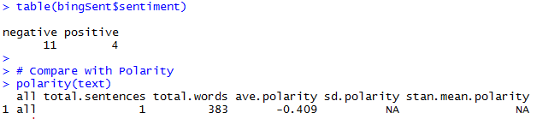
6_TidyText_Sentiment.R
The polarity function from qdap and the inner_join show similar negative results.
Weeknd Lyrics
Bing Lexicon

Slide 66
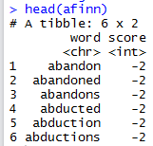
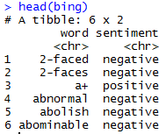
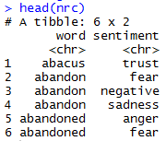
6_TidyText_Sentiment.R
The sentiments tibble has multiple lexicons. Each can be used in an inner join to get different ways of assessing sentiment.
AFINN- Dutch researcher
Words scored -5 to 5
Bing- UofI-Chi Researcher
Words scored Pos/Neg
NRC – mTurk
Words classified into 8 primary & pos/neg
Weeknd Lyrics
Bing Lexicon

Slide 67
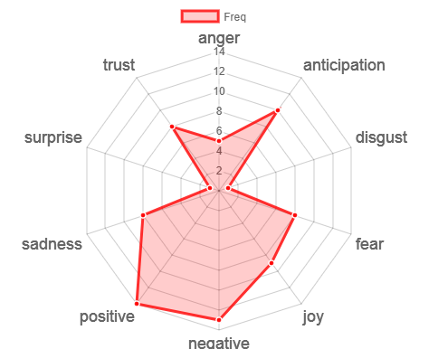
Remember Plutchik’s Wheel of emotion? Let’s mimic it!
You could remove Pos/Neg before making the radarchart to more closely fit the wheel.

Slide 68
6_TidyText_Sentiment.R

Slide 69
Intro to TM w/R Deep Dive
What is Text Mining?
String Manipulation & Cleaning
Frequency Counts, Dendrograms & Wordclouds
Sentiment Analysis
Topic Modeling
OpenNLP/Named Entity Recognition
Goals:
Learn the basics of text mining
Apply methods to real data and uses
Follow a business workflow for stakeholders needing text mining insights

Slide 70
Topic Modeling
LDA
Example
Each document is made up of mini topics.
Corpus
I like to watch basketball and football on TV.
I watched basketball and Shark Tank yesterday.
Open source analytics software is the best.
R is an open source software for analysis.
I use R for basketball analytics.
Probability is assigned to each document for the specific observed topics.
A document can have varying probabilities of topics simultaneously.
LDA Topics
Topic A: 30% basketball, 20% football, 15% watched, 10% TV…something to do with watching sports
Topic B: 40% software, 10% open, 10% source…10% analytics something to do with open source analytics software
Technical Explanations:
http://en.wikipedia.org/wiki/Latent_Dirichlet_allocation
http://cs.brown.edu/courses/csci2950-p/spring2010/lectures/2010-03-03_santhanam.pdf
*Full disclosure I am not an expert in topic modeling
Documents
100% Topic A
100% Topic A
100% Topic B
100% Topic B
60% Topic B, 40% Topic A

Slide 71
7_TopicModeling_Sentiment.R
LDA Topic Modeling
Setup
library(topicmodels) is not actively maintained. So, library(lda) is used here.
txtLex<-lexicalize(txt)
Reads raw text, and creates a corpus of n “articles”, and complete word lexicon.
txtWordCount<-word.counts(txtLex$documents, txtLex$vocab)
txtDocLength<-document.lengths(txtLex$documents)
Word counts for each article
Number of words in each article
# LDA Topic Modeling
k <- 5
num.iter <- 25
alpha <- 0.02
eta <- 0.02
set.seed(1234)
fit <- lda.collapsed.gibbs.sampler(documents = txtLex$documents, K = k,vocab = txtLex$vocab,
num.iterations = num.iter,alpha = alpha, eta = eta,
initial = NULL, burnin = 0,compute.log.likelihood = TRUE)
Parameters
Model Fit

Slide 72
7_TopicModeling_Sentiment.R
Setup
LDA Topic Modeling
One of the cool things about lda is that you can find the prototypical document
# Prototypical Document
top.topic.documents(fit$document_sums,1)
[1] 21 23 2 24 3
Since K= 5, the 21 article best represents the first topic and so on.
> text$webTitle[21]
[1] "A little shared knowledge goes a long way in helping to scale social enterprise"

Slide 73
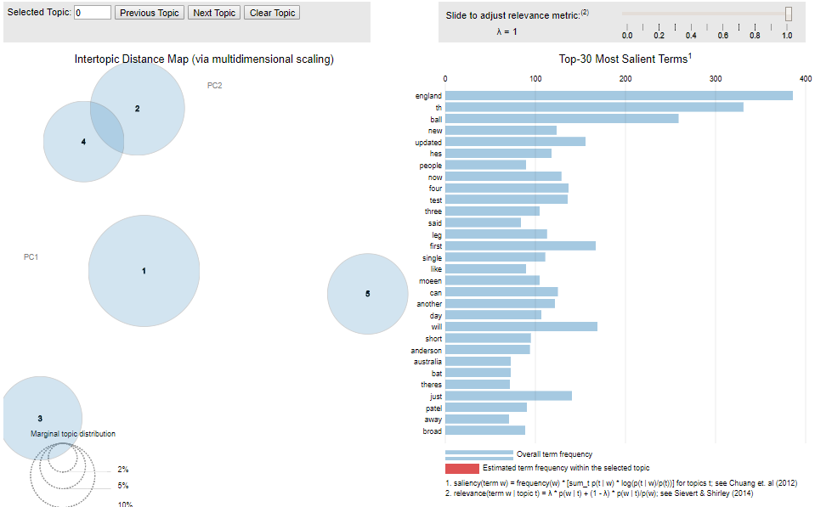
7_TopicModeling_Sentiment.R
Setup
Better yet, let’s explore in a dynamic gui w/ ldaVis
# LDAvis params
theta <- t(pbapply(fit$document_sums + alpha, 2, function(x) x/sum(x)))
phi <- t(pbapply(t(fit$topics) + eta, 2, function(x) x/sum(x)))
ldaJSON <- createJSON(phi = phi,
theta = theta,
doc.length = txtDocLength,
vocab = txtLex$vocab,
term.frequency = as.vector(txtWordCount))
serVis(ldaJSON)

Slide 74
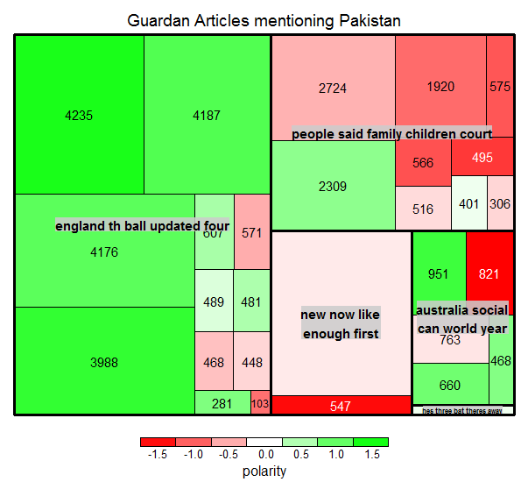
7_TopicModeling_Sentiment.R
Setup
TREEMAP: multi dimensional representation of the corpus attributes.
Each article is a small square
The area of the square is related to the number of terms document length
Color will represent quick, simple polarity from qdap
The larger grouping is based on LDA topic assignment
End result is understanding broad topics, their sentiment and amount of the corpus documents devoted to the identified topic.

Slide 75
7_TopicModeling_Sentiment.R

Slide 76
Intro to TM w/R Deep Dive
What is Text Mining?
String Manipulation & Cleaning
Frequency Counts, Dendrograms & Wordclouds
Sentiment Analysis
Topic Modeling
OpenNLP/Named Entity Recognition
Goals:
Learn the basics of text mining
Apply methods to real data and uses
Follow a business workflow for stakeholders needing text mining insights

Slide 77

Remember this? Text Mining Approaches
“Lebron James hit a tough shot.”
Semantic Using Syntactic Parsing
Bag of Words
Lebron
a
James
hit
tough
shot

Slide 78

Named Entity Recognition using OpenNLP
R’s OpenNLP package wraps the Apache OpenNLP project. However, documentation & examples can be hard to come by.

Slide 79
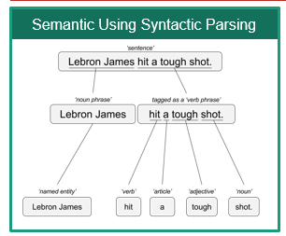
8_Open_Language_Processing.R
library(openNLP)
Setup
https://rpubs.com/lmullen/nlp-chapter
Uses Annotators to identify the specific item in the corpus. Then holds all annotations in a plain text document. Think of auto-tagging words in a document and saving the document terms paired with the tag.
Documentation, examples are hard to come by!
Annotations
Grammatical or POS (Part of Speech) Tagging
Sentence Tagging
Word Tagging
Named Entity Recognition
Persons
Locations
Organizations

Slide 80
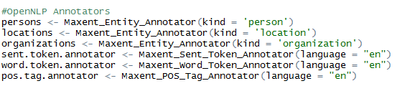
8_Open_Language_Processing.R
Setup
Annotations Specified
Annotations Applied to Text
Annotate is used in ggplot2 SO you must either change the above to NLP::annotate(…) or ensure ggplot2 is not loaded in your environment!

Slide 81
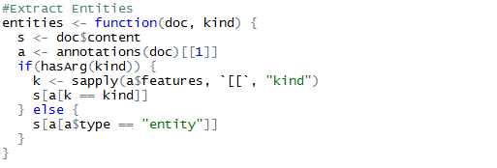
8_Open_Language_Processing.R
Setup
The annotated plain text object is large with a complex structure. This function allows us to extract the tokens by tag kind.

Slide 82
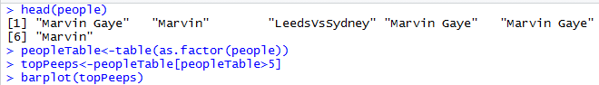
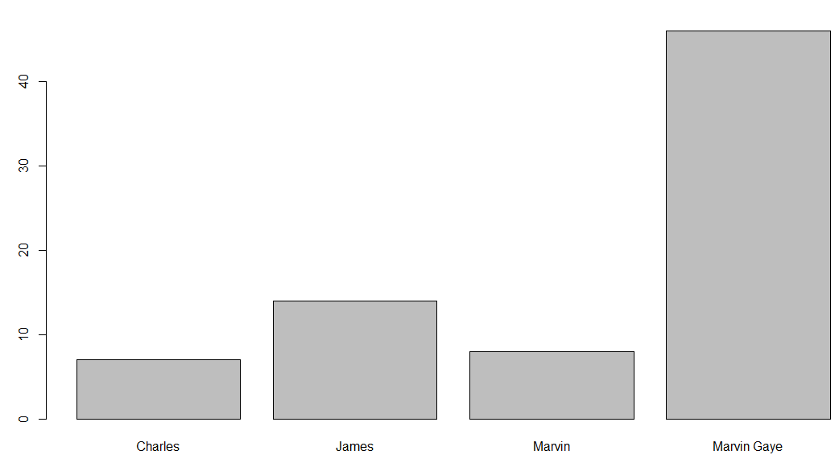
8_Open_Language_Processing.R
The function creates a vector of people, locations and orgs that were “recognized”
Setup

Slide 83
8_Open_Language_Processing.R

Slide 84
Workshop Agenda
9-10:45
Intro to TM w/R
10:45-11
Break
11 – 11:45
Gather Text
11:45 – 12
Break
12-12:40
HTML Widgets
& Flexdashboard
12:40-12:50
Optional
Break
12:50-1
Scheduling
Goals:
Learn the basics of text mining
Apply methods to real data
Follow a business workflow for stakeholders needing text mining insights

Slide 85
Review: read.csv()
To read a single “comma separated value” file (.csv):
text<-read.csv('coffee.csv', header=TRUE)
Part of utils package installed with base R. Used for tabled data with a “delimited” to create a data.table.
Example: 1_Keyword_Scanning.R
Some of the alternatives include:
Package::Function | Description
data.table::fread() | Fast And Friendly File Finagler
readr::read_csv() | Read A Delimited File (Including Csv & Tsv) Into A Tibble
ff::read.csv.ffdf() | “Imports csv files into ff data frames (memory-efficient storage of large data on disk and fast access functions)
sqldf::read.csv.sql() | Read File Filtered By SQL statement
bigmemory::read.big.matrix() | Package for working with “massive matrices” File Interface For A ``Big.Matrix'‘ class

Slide 86
Review: read.csv() with Multiple Files*
Start with a vector of .csv files OR you can use
txtFiles<-c('chardonnay.csv','coffee.csv','beer.csv')
OR if you have a folder with many
txtFiles<-list.files(pattern = “*.csv”)
Example: 5_Other_Wordclouds.R
A For loop will read each file individually and add it to the environment.
for (i in 1:length(txtFiles)){
assign(txtFiles[i], read.csv(txtFiles[i]))
cat(paste('read completed:',txtFiles[i],'\n'))
}
Using lapply or pblapply (personal preference) will put all individual files into a single list
all<-pblapply(txtFiles,read.csv)
rbindlist() from data.table is an efficient way to collapse the list of documents if needed.
*You can actually use this code to read other file types if you change read.csv

Slide 87
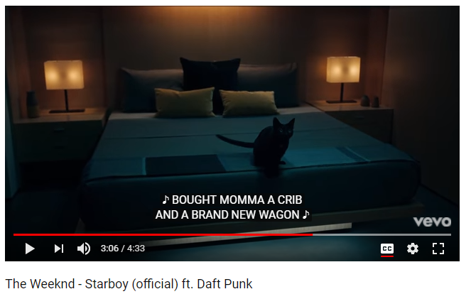
Plain Text files: readLines()
# Data
text<-readLines('Weeknd.txt')
Example: 6_TidyText_Sentiment.R

Slide 88
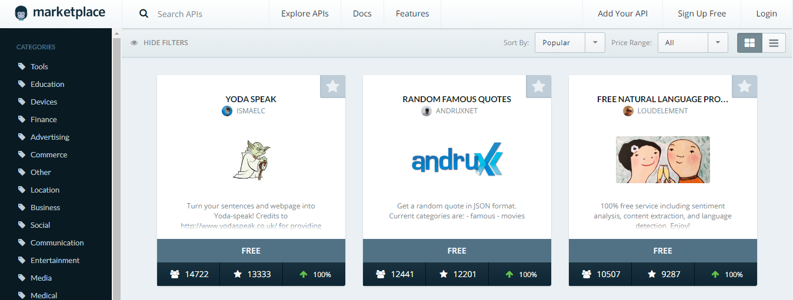

Now onto APIs!!
Mashape.com
ProgrammableWeb.com
Plus literally millions of others waiting to be found!

Slide 89

Getting Text from an API: What is an API?
Application Program Interface (API)
Clearly defined methods of communication between various software components.

Slide 90




APIs are behind many of the sites you use today.
Google Maps API Services include
Geocoding (get lat/lon from name & vice versa)
Base map “tiles”
Basic Geographic Info
www.google.com/maps/place/Cleveland,+OH/@41.4951143,-81.8462865,11z
maps.googleapis.com/maps/api/staticmap?center=cleveland,+oh&zoom=10&size=640x640&scale=2&maptype=terrain
maps.googleapis.com/maps/api/geocode/json?address=cleveland&sensor=false

Slide 91

In our diagram, the browser/maps interface…
“Your Chrome browser interacts with the maps API services to render the information.

Slide 92




APIs can help unlock information…
Need song lyrics?
Access the Closed Caption API file called “timedtext.
https://www.youtube.com/watch?v=34Na4j8AVgA

Slide 93
Two popular formats.
XML – Extensible Markup Language
Extensible Markup Language is a markup language that defines a set of rules for encoding documents in a format that is both human-readable and machine-readable.
Ever wonder why Excel files went from xls to xlsx? The data is stored as XML.
JSON- Javascript Object Notation
is an open-standard file format that uses human-readable text to transmit data objects consisting of attribute–value pairs and array data types.
Respone in XML or JSON
Ask a question

Slide 94


Comparing the two formats
http://maps.googleapis.com/maps/api/geocode/xml?address=boston&sensor=false
http://maps.googleapis.com/maps/api/geocode/json?address=boston&sensor=false

Slide 95
Types of API requests
HTTP GET - Use GET requests to retrieve resource representation/information only e.g. your browsers GETs google map information
HTTP POST/PUT - Use POST APIs to create new subordinate resources e.g. you post a file to kaggle, it is scored and the response is a change in your ranking
HTTP DELETE - DELETE APIs are used to delete resources
HTTP PATCH – PATCH requests are to make partial update on a resource e.g. updating an existing customer record
Generally, a response in the 200s, is a success and anything in the 400s is considered a failure for various reasons.

Slide 96
Let’s try an API
Request Helpers:
www.Hurl.it
PostMan Chrome Add-in or software
Simple API interactions
https://newsapi.org/
https://pipl.com/dev/demo
http://maps.googleapis.com/maps/api/staticmap?center=Boston+MA&zoom=10&size=640x640

Slide 97
Files to Open
XML Example
https://github.com/kwartler/ODSC/blob/master/p2_Get_Text/GetXML.R
GetXML.R
JSON Example
https://github.com/kwartler/ODSC/blob/master/p2_Get_Text/instruction_newsAPI.R
instruction_newsAPI.R

Slide 98
Workshop Agenda
9-10:45
Intro to TM w/R
10:45-11
Break
11 – 11:45
Gather Text
11:45 – 12
Break
12-12:40
HTML Widgets
& Flexdashboard
12:40-12:50
Optional
Break
12:50-1
Scheduling
Goals:
Learn the basics of text mining
Apply methods to real data
Follow a business workflow for stakeholders needing text mining insights

Slide 99



HTML Widgets
www.HTMLWidgets.org
Let’s an R programmer use JavaScript libraries!
Dynamic meaning a user can interact with the plot
Easy to do from within the R console without JS knowledge
“ships” with all the underlying data, so basic exploration/plotting doesn’t need a Shiny or OCPU backend.
http://www.htmlwidgets.org/showcase_leaflet.html
http://www.htmlwidgets.org/showcase_threejs.html
http://www.htmlwidgets.org/showcase_dygraphs.html

Slide 100
instruction_htmlWidgets.R

Slide 101

FlexDashboard
http://rmarkdown.rstudio.com/flexdashboard/
Let’s an R programmer use HTML with Javascript!
Embed the htmlwidgets, or other plots
Easy to do from within the R console without HTML knowledge
Easily change the layout of the dashboard.
Authoring is done in Rmarkdown (.Rmd) files by “knitting” the components & output is HTML for easy viewing

Slide 102
Open these files:
blank_dashboard.Rmd
top_focal.Rmd

Slide 103
Workshop Agenda
9-10:45
Intro to TM w/R
10:45-11
Break
11 – 11:45
Gather Text
11:45 – 12
Break
12-12:40
HTML Widgets
& Flexdashboard
12:40-12:50
Optional
Break
12:50-1
Scheduling
Goals:
Learn the basics of text mining
Apply methods to real data
Follow a business workflow for stakeholders needing text mining insights

Slide 104
Open these files:
cronDash.Rmd
cronJob.R

Slide 105



Use a scheduler to automate the construction & dissemination of your work!
R Studio cronR Add-In
*Windows task scheduler will be similar.

Slide 106
Questions?
@tkwartler
www.linkedin.com/in/edwardkwartler
https://github.com/kwartler/ODSC

